Slide 1
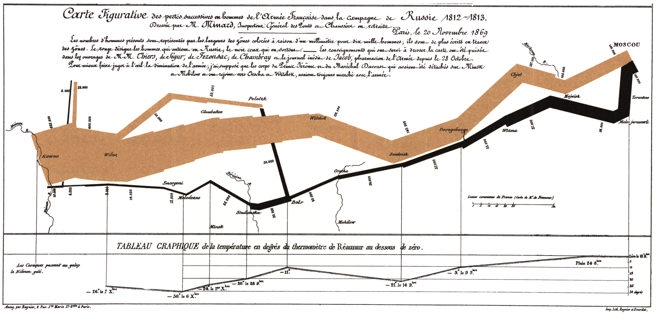
Data Visualization
Spring 2021
E137 02-01

Slide 2
Let’s talk about this chart
Joseph Charles Minard's 'Carte figurative des pertes successives en hommes de l'Armée Française dans la campagne de Russie 1812-1813.’
“best statistical graph ever drawn” – Edward Tufte

Slide 3
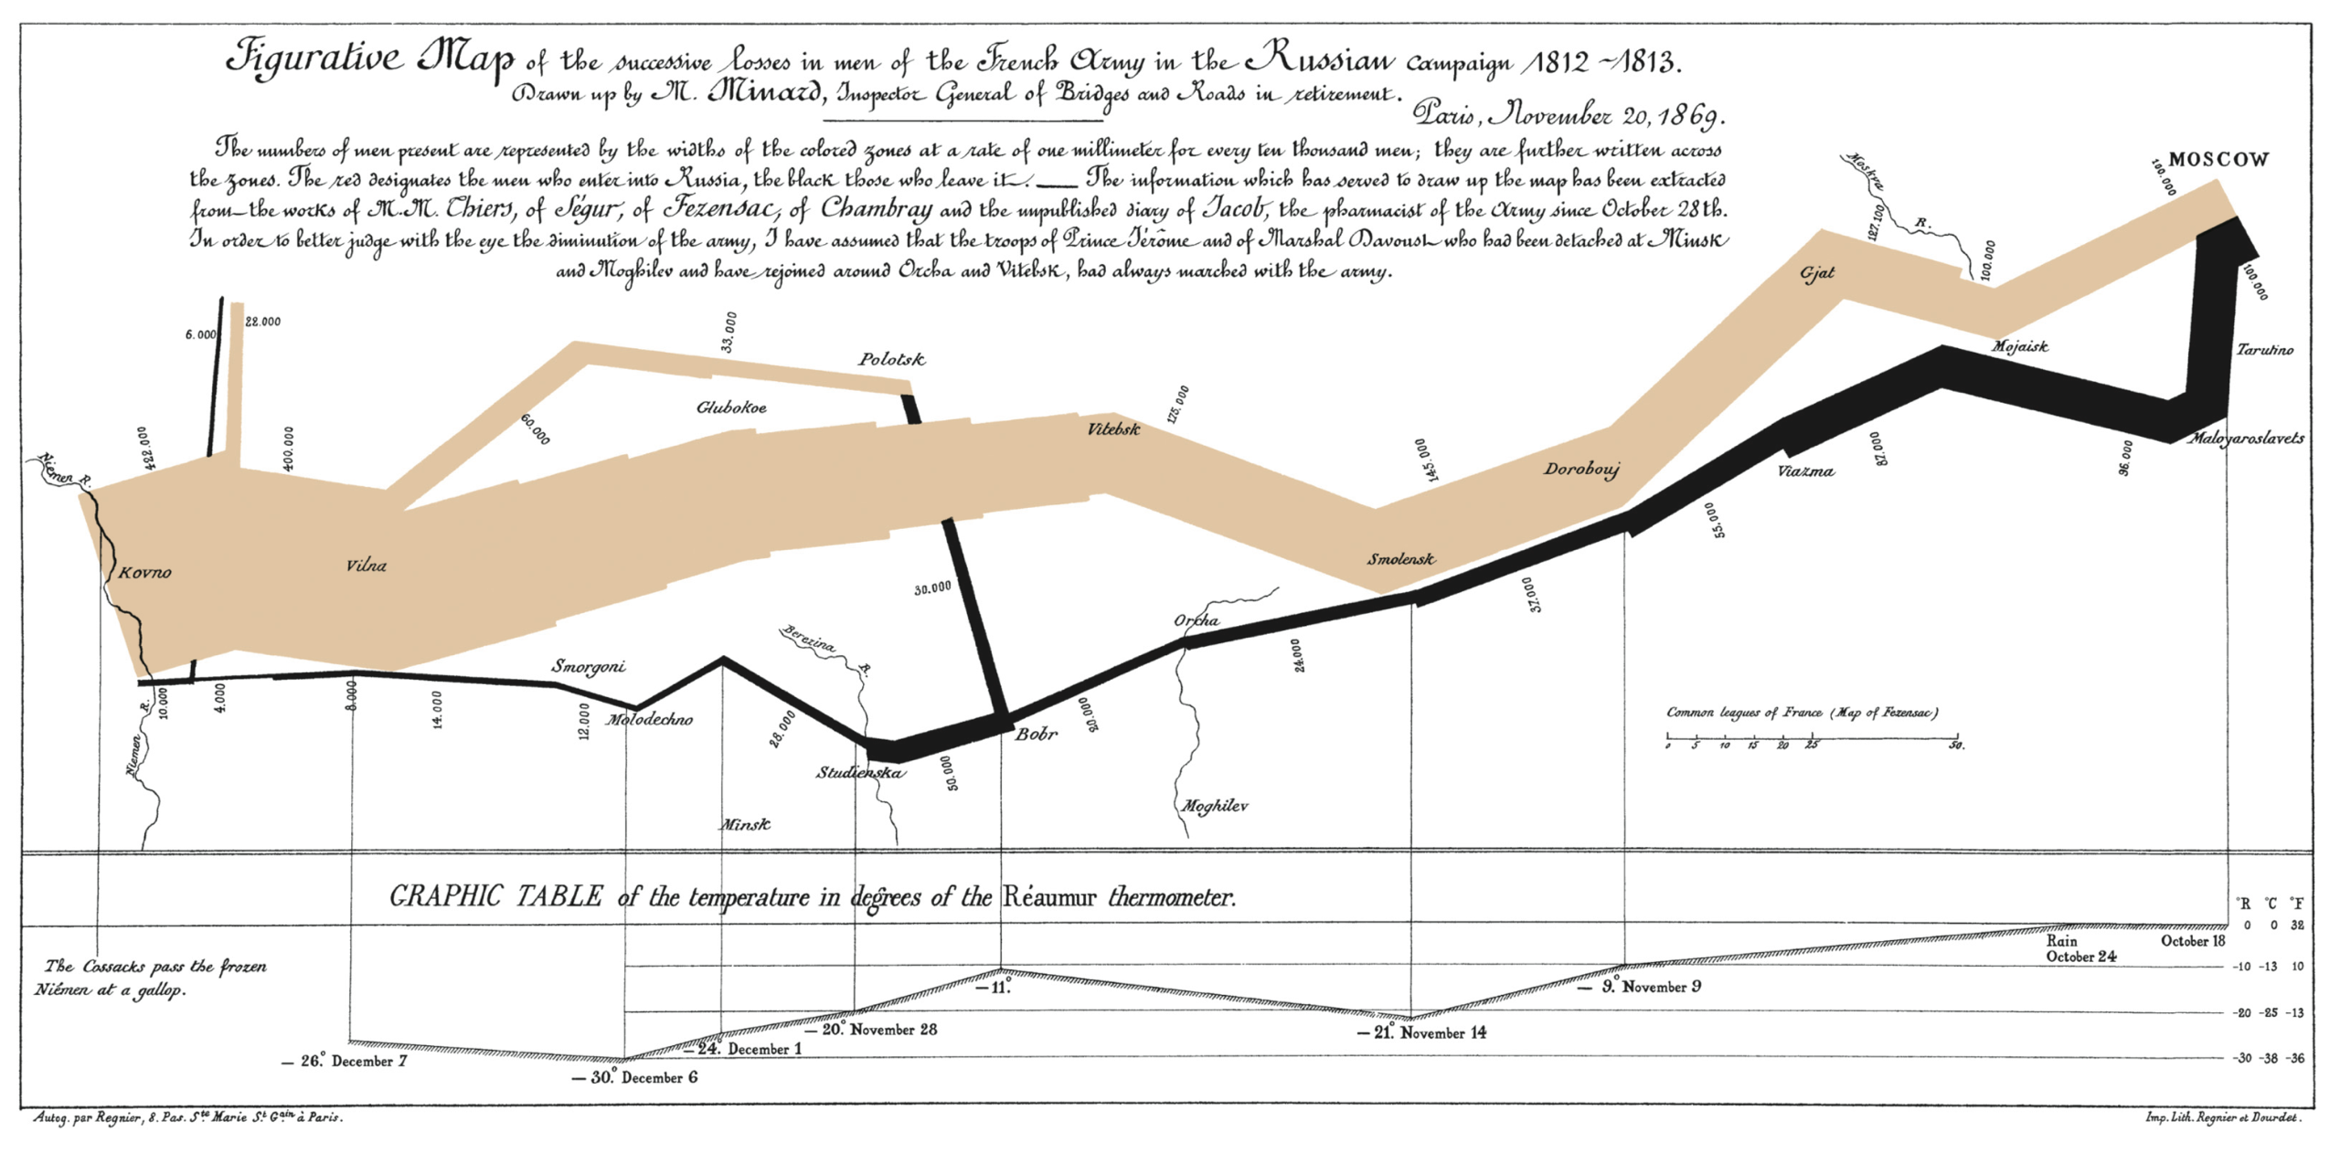
Let’s use an English version
Joseph Charles Minard's 'Carte figurative des pertes successives en hommes de l'Armée Française dans la campagne de Russie 1812-1813.’
“best statistical drawings ever created” – Edward Tufte

Slide 4
Take a look → what can you take away?
Notes:
https://www.edwardtufte.com/tufte/minard

Slide 5
Today
Overview of data visualization
Share our CRAPpy graphs
Leaning on Andrew Heiss, here!

Slide 6
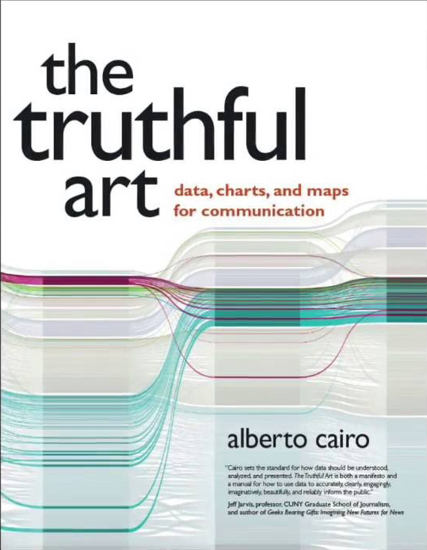




Heroes of the day

Slide 7
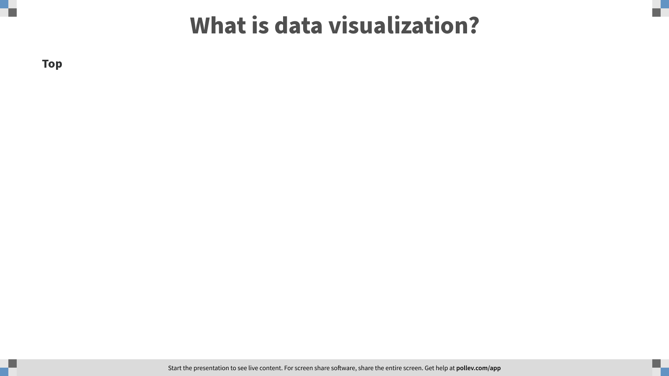
Notes:
What is data visualization?
https://www.polleverywhere.com/discourses/SEf69Sw9WRm0w3eObmaoP

Slide 8
”A data visualization is a display of data designed to enable analysis, exploration, and discovery.”

Slide 9
What makes data visualization “good”?

Slide 10
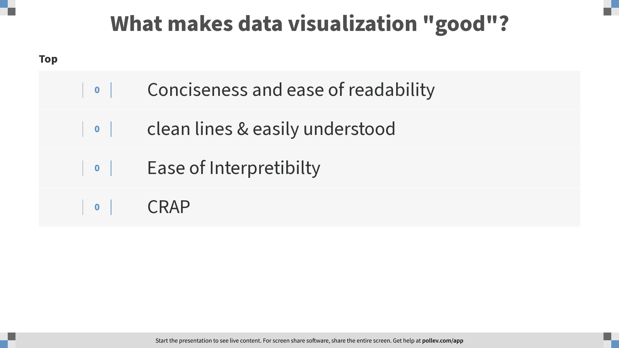
Notes:
What makes data visualization "good"?
https://www.polleverywhere.com/discourses/c7pTD3iWY36CYFohavZic

Slide 12
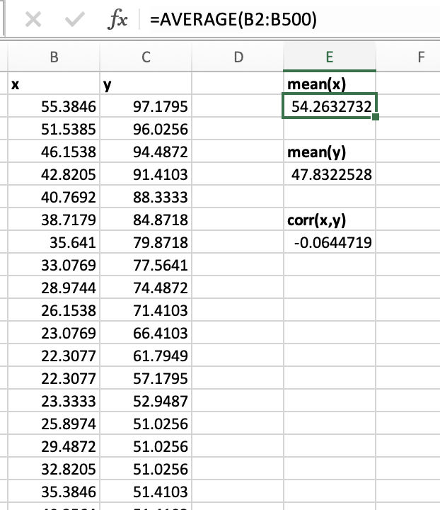
Got some data!

Slide 13


Slide 14
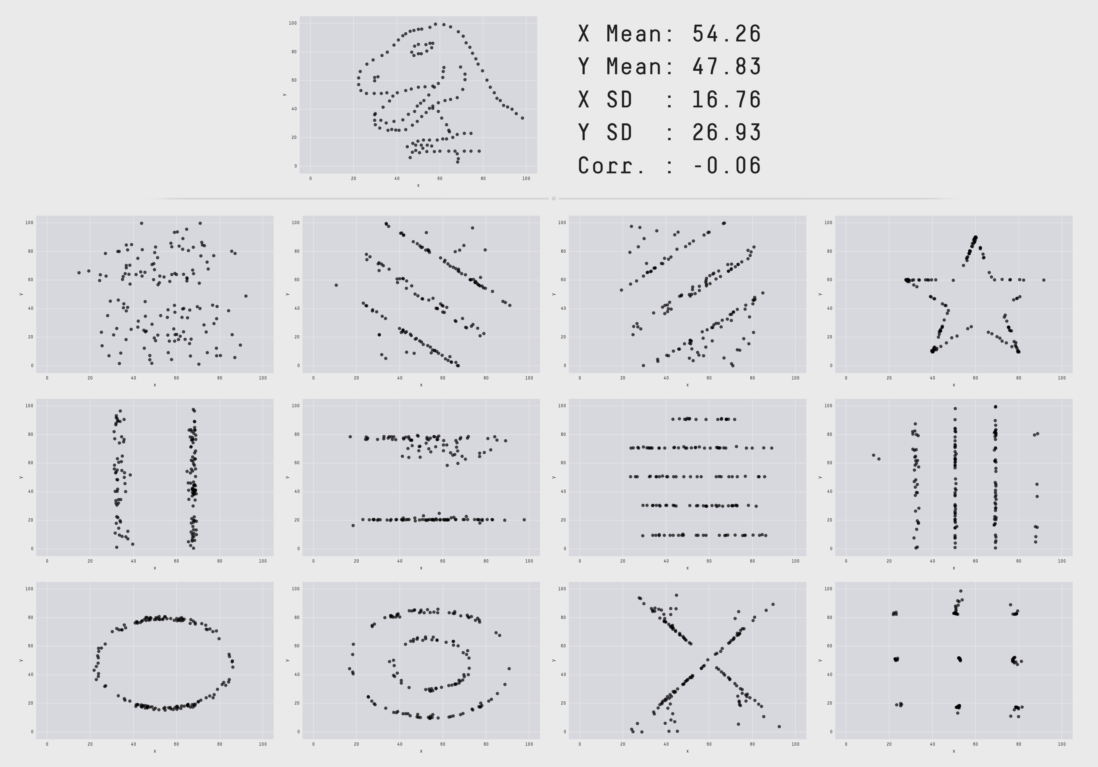
Same mean, standard deviation, same correlation!
Datasaurus Dozen

Slide 15
Humans love patterns

Slide 16
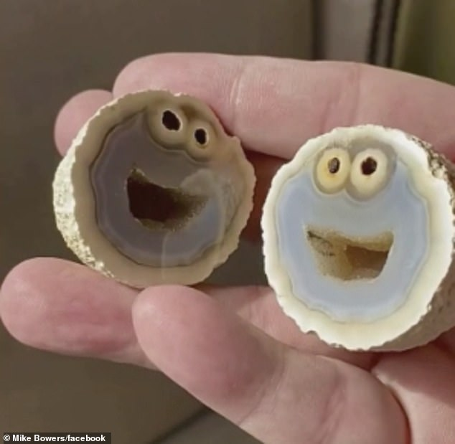
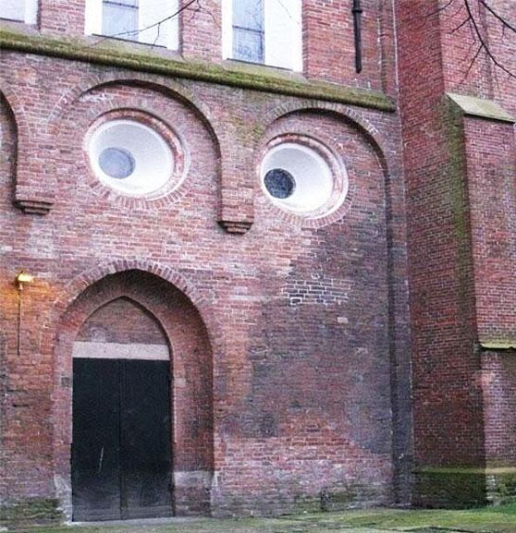
Humans LOVE patterns
Pareidolia: Seeing patterns that just aren’t there

Slide 17
Data visualizations help us see the patterns

Slide 18
What makes a great visualization?
"Graphical excellence is the well-designed presentation of interesting data—a matter of substance, of statistics, and of design … [It] consists of complex ideas communicated with clarity, precision, and efficiency. … [It] is that which gives to the viewer the greatest number of ideas in the shortest time with the least ink in the smallest space … [It] is nearly always multivariate … And graphical excellence requires telling the truth about the data."
Edward Tufte, The Visual Display of Quantitative Information, p51

Slide 19
What makes a great visualization?
Good aesthetics
No substantive issues
No perceptual issues
Honesty + good judgment
Kieran Healy, Data Visualization: A Practical Introduction

Slide 20
What makes a great visualization?
Truthful
Functional
Beautiful
Insightful
Enlightening
Albert Cairo, The Truthful Art

Slide 21
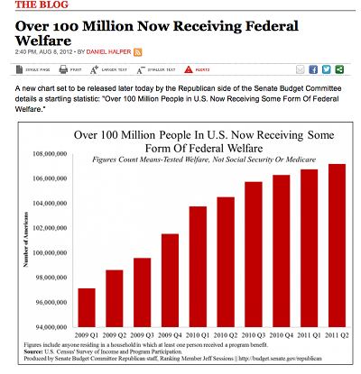
Truthful
It is based on thorough and honest research

Slide 22
Truthful
“It is based on thorough and honest research”

Slide 23
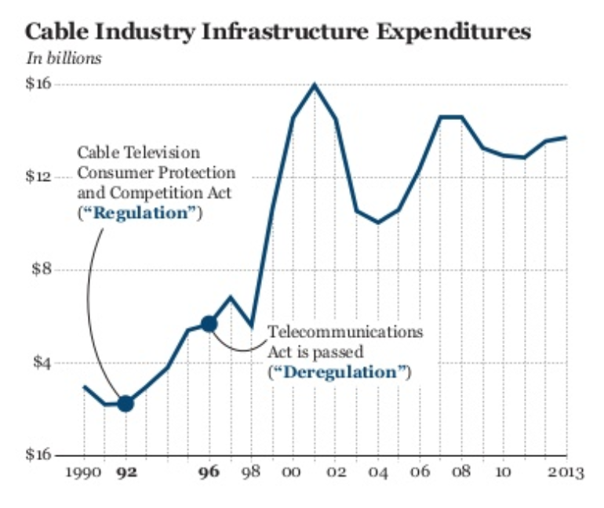
Truthful
“It is based on thorough and honest research”

Slide 24
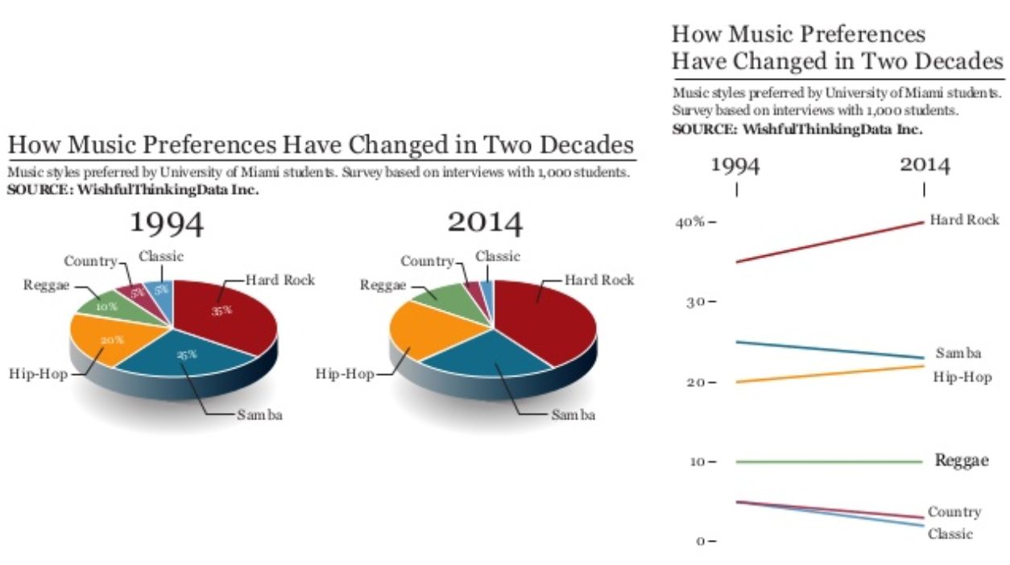
Functional
”Constitutes an accurate depiction of the data,”
and people get it.

Slide 25
Functional
”Constitutes an accurate depiction of the data,”
and people get it.
HT: Andrew Heiss

Slide 26
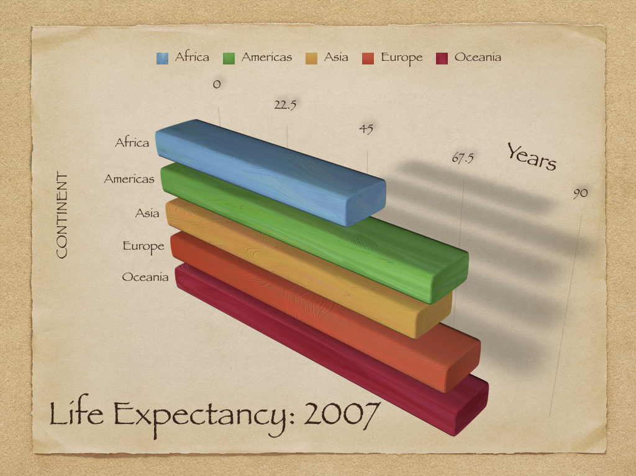
Beautiful
Kieran Healy
People actually want to look at it

Slide 27
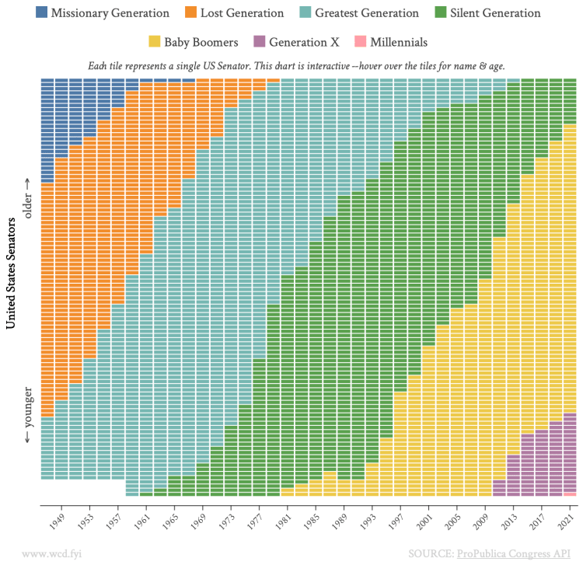
Beautiful

Slide 28
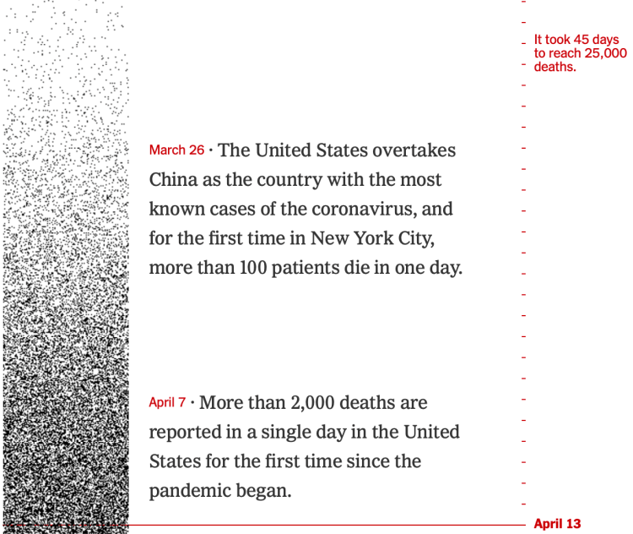
Insightful
NYTimes
“Reveals evidence that we would have a hard time seeing otherwise”
Enlightening
“It will change our minds for the better”
Do good with data
Do good with data
Notes:
https://www.nytimes.com/interactive/2021/01/27/us/us-coronavirus-deaths-rate.html

Slide 29
Oh, CRAP
Contrast
Repetition
Alignment
Proximity

Slide 30
Contrast
If two items are not the same, make them different
Really different
REALLY
Don’t be a wimp

Slide 31
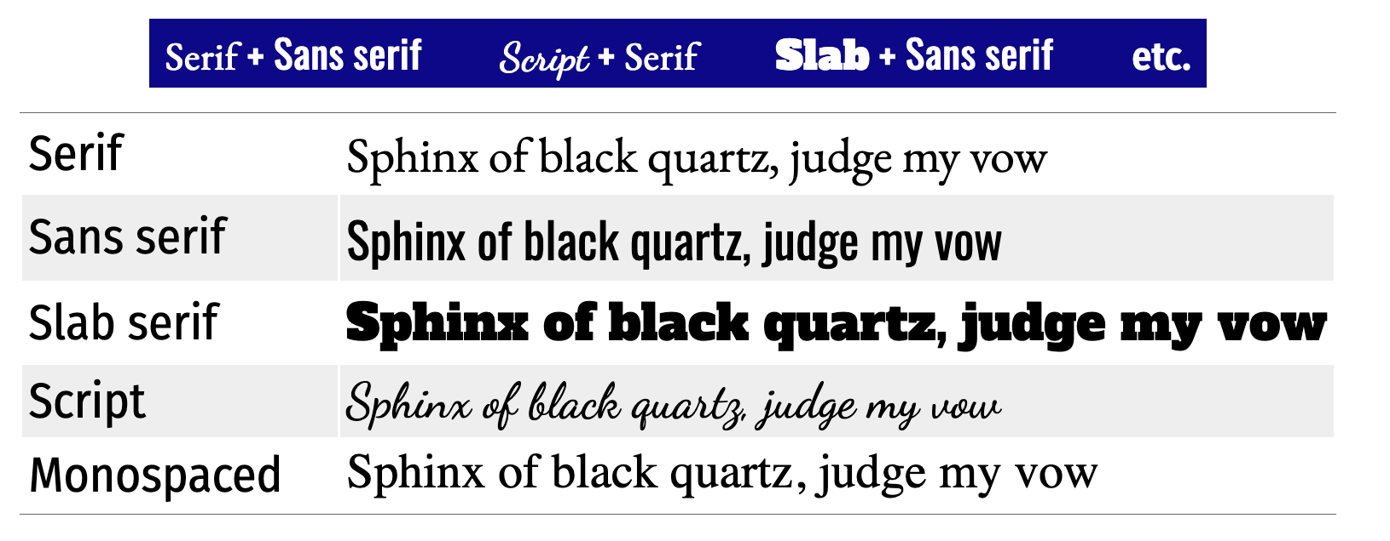
Use different font families

Slide 32
Add contrast within font families

Slide 33
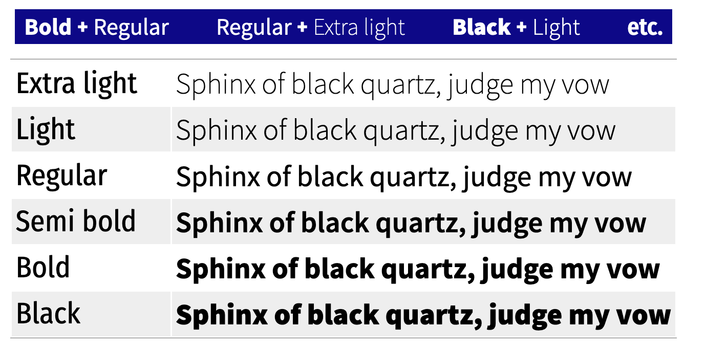
Use contrasting weights in same family

Slide 34
Contrasting sizes
Giant
Big
Regular
Small

Slide 35
Contrasting colors
http://color.adobe.com

Slide 36
Repetition
Repeat some aspect of the design
Colors
Fonts
Graphical elements
Alignment

Slide 37
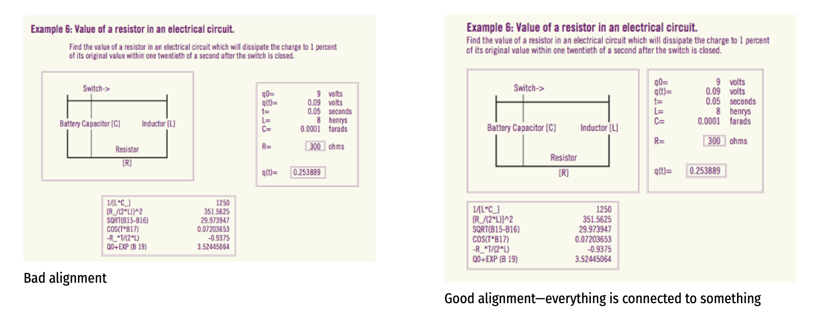
Alignment
Every element needs a visual connection to something else

Slide 38
Alignment
Every element needs a visual connection to something else

Slide 39
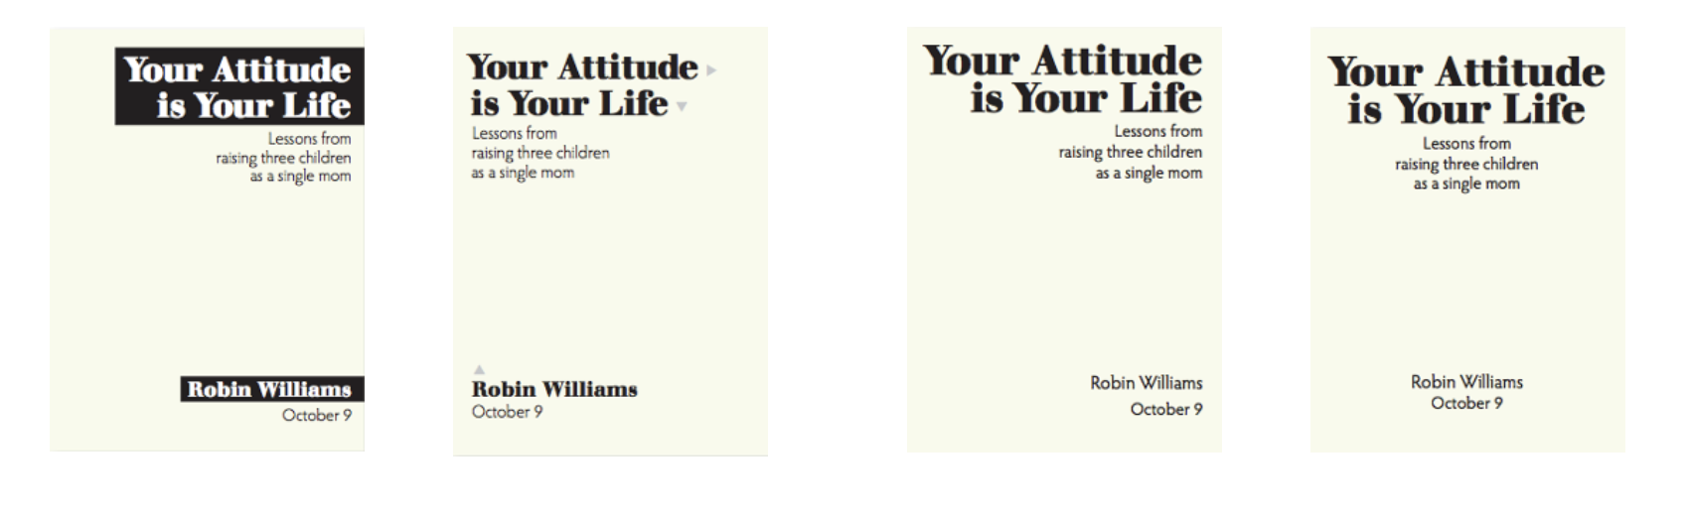

Slide 40
In your groups
Open your doc
Share your CRAPpy charts
Now, assess on our five dimensions
Truthful
Functional
Beautiful
Insightful
Enlightening
Select a “best” one to share with your group

